Slide 1


Hospital Readmissions
Great River Medical Center
-- Diabetic Patients --
Analyst: Daniel Evenschor

Slide 2
Problem Statement
Cost of readmitted patients high
→ Limit patient readmission
Build a prediction model
Identify top 100 patients for pilot project
Get insights for Hospital
Notes:
The cost of readmissions is largefor both the patient and hospital. diabetes is cited as the third leading cause of hospital readmissions.
Patient readmission causes negative impact on patient quality of life, strains the medical staff as well as insurance and government supplementals might be denied if readmitted before 30 days pass

Slide 3
Agenda
Data
Assumptions & Limitations
Model Selection
Insights --> Top 100
Recommendations & Conclusion

Slide 4
Data
44 Columns 10000 Rows = 440,000 datapoints
~ 3% missing values
Data for diabetic patients
Hospital Info
Medical Info
Patient Info
Predict: readmission within 30 days
Notes:
Medical Info: "max_glu_serum" "A1Cresult" "metformin" "repaglinide" "nateglinide" "chlorpropamide" "glimepiride" "acetohexamide" "glipizide" "glyburide" "tolbutamide" "pioglitazone" "rosiglitazone" "acarbose" "miglitol" "troglitazone" "tolazamide" "examide" "citoglipton" "insulin" "change" "diabetesMed"
Hospital: "admission_type_id" "discharge_disposition_id" "admission_source_id" "time_in_hospital" "medical_specialty" "num_lab_procedures" "num_procedures" "num_medications" "number_outpatient" "number_emergency" "number_inpatient" "number_diagnoses" "diag_1_desc" "diag_2_desc" "diag_3_desc“
Patient: "race" "gender" "age" "wgt" "payer_code" "readmitted_y"

Slide 5
Assumptions, Decisions and Limitations
Missing Values: “?”, “”, “Not Available”
Race → “Other”
Patients that expired, discharged for hospice
Payercode, Diagnostics, medical specialty
Relationship between Source and Type
Accuracy of the prediction model
75% of top 100 patients actually readmitted
Notes:
Admission_source_id – admission_type_id

Slide 6
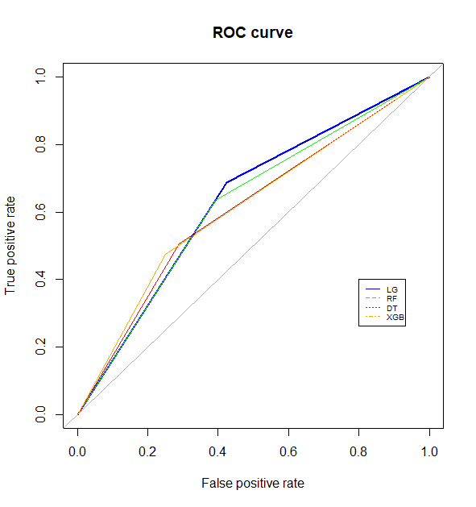
Model Selection
Logistic Regression: 0.63
Random Forest: Avg. 0.62
Decision Tree: 0.61
eXtreme Gradient Boosting: Avg. 0.61
→ Logistic Regression
Notes:
After extensive preprocessing, onehot encoding and balancing of the dataset
The following models were instantiated:
after repeatedly (5x) training all of the 4 models and evaluating their AUC – Area under the curve of th
ROC – Receiver operating Characteristic
The highest AUC is consistently achieved by the Logistic Regression model# Therefore I will use this model to get my insights
All models were hyperparameter tuned, fitted using 5 fold crossvalidation and optimized cutoff for the best possible AUC performance

Slide 7
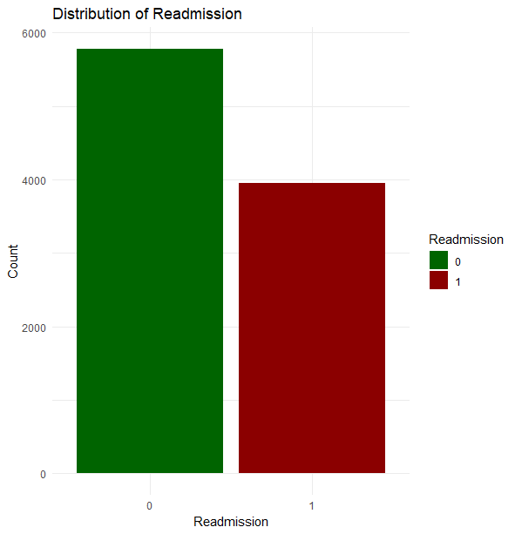
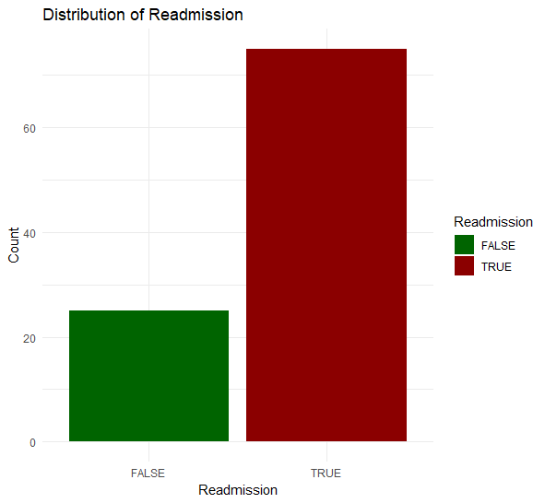
Data Prediction
60%
75%
40%
25%
Notes:
75% of the top 100 patients to be readmitted according to my model are actually readmitted

Slide 8
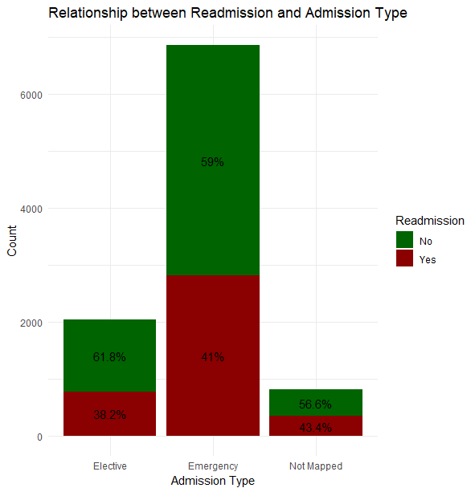
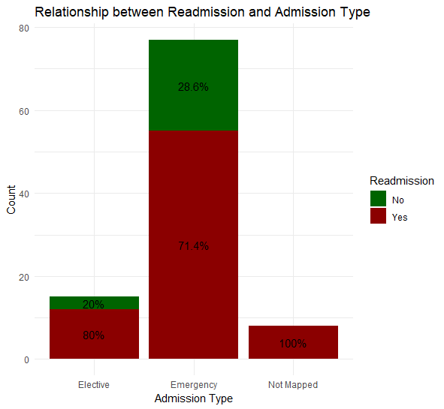
Data Prediction
Notes:
According to the data gathered by the hospital, patients whos admission type was volutarilly (Elective) had a slightly lower chance to be readmitted within 30 days comparing to ones that were admitted due to an emergency. This is also mirrored in the prediction model. Note that the overall distribution remained similar and the 2% difference in the dataset is not significant enough for a strong insight

Slide 9
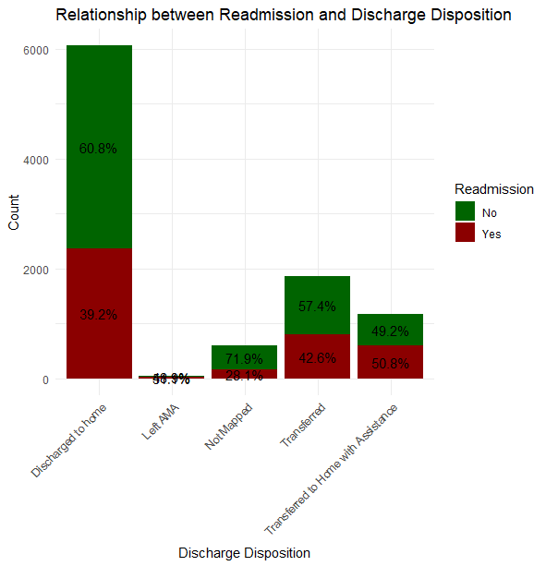
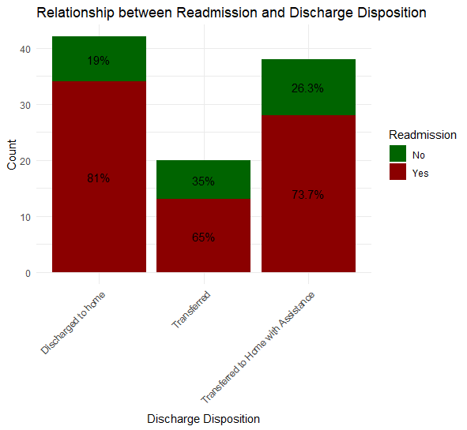
Data Prediction
51.1%
48.9%
Notes:
Looking at the two graphs, the most concerning group is the patients that are transferred home with assistance. They have a 10 % higher chance to be readmitted. Most patients discharged to home because their treatment is completed, so they are also expected to show up in the top 100 patients by prediction. However, Even though there are way less datapoints for patients that are transferred to home with assistance they show up in the top 100 predicted patients with similar frequency to patients that have been discharged home without assistance. This underlines that such patients might better stay in the hospital for better treatment, since the assistance at home might be less professional and lead to challenges that cause an early readmission.

Slide 10
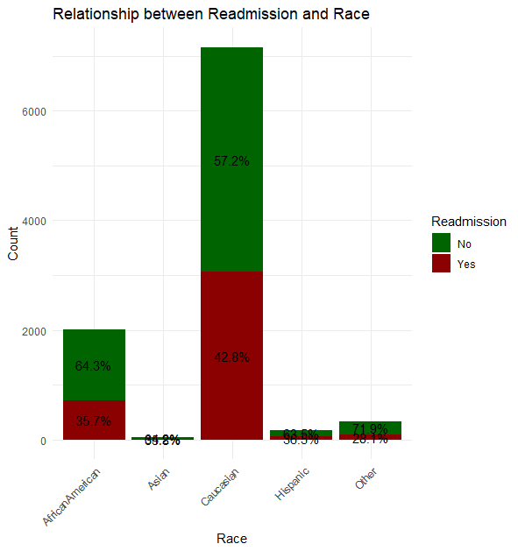
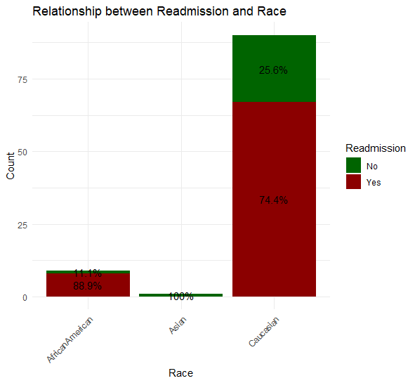
Data Prediction
28.1%
71.9%
64.8%
34.2%
36.5%
63.5%
Notes:
Most of the patients in our hospital are either Caucasian or afro American, that is reflected in the patients most likely to be readmitted according to the prediction model are overwhelmingly Caucasian and African American.

Slide 11
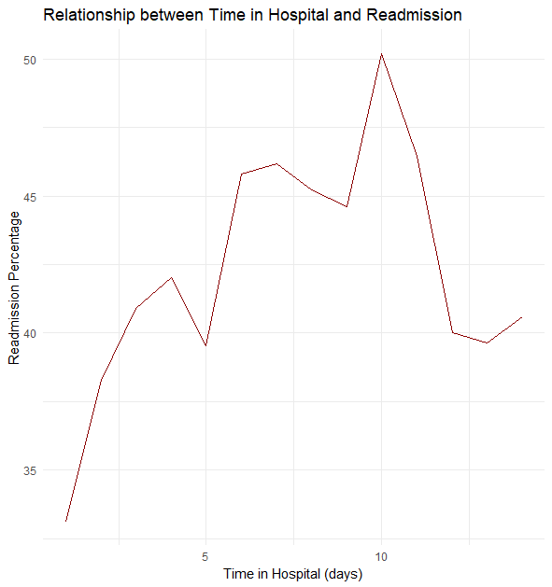
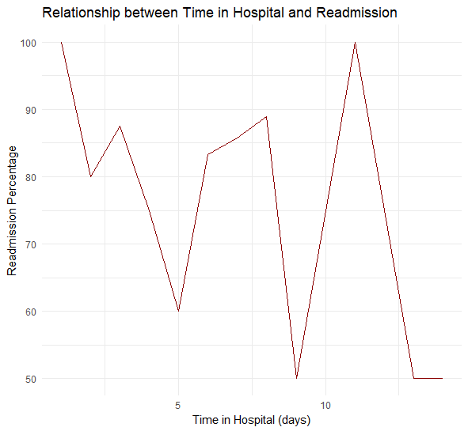
Data Prediction
Notes:
The general trend in the hospital data shows that patients that remained in the hospital for 10 days have the highest chance of readmission. In the linechart with the top100 patients there might be some outliers leading to a slight misrepresentation in the trend with one patient being readmitted after staying in the hospital only one day. The trend that was identified has also been picked up by the prediction model being represented by the spike of readmission around discharge after 10 days. This might be because patients that should have remained in the hospital for one or two more days are discharged slightly early to relief workload on the medical staff, in the hopes that everything will be fine

Slide 12
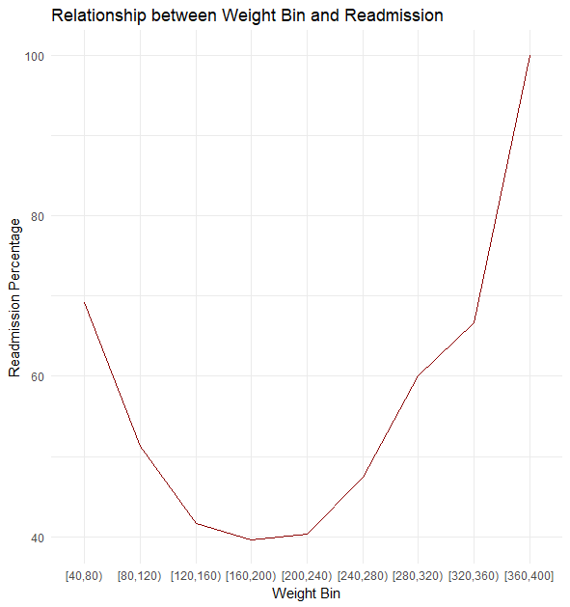
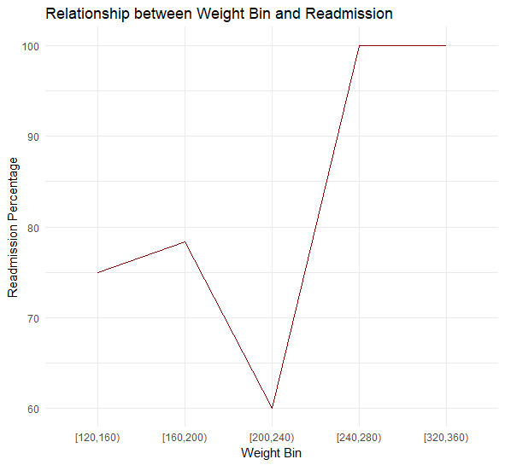
Data Prediction
Notes:
According to a recent study conducted in 2022 by the University of Texas an increased BMI in patients with lung cancer is associated with higher risks of readmission as well as higher readmission costs. This is also reflected in our hospitals dataset where patients that are overweight seem to have increased chances of readmission. This is further underlined with the weight classes represented in the top 100 patients to be readmitted.
Source : https://www.ncbi.nlm.nih.gov/pmc/articles/PMC9310118/

Slide 13
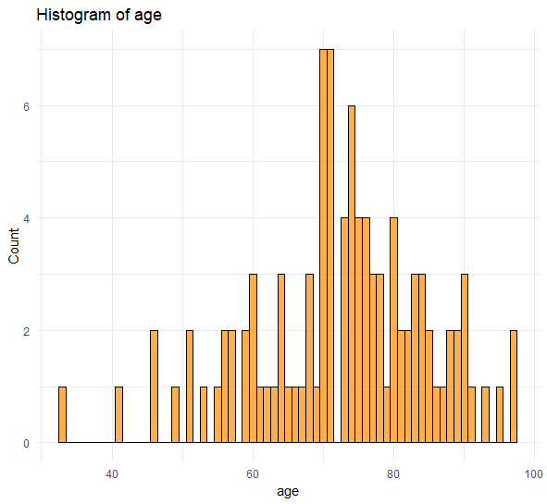
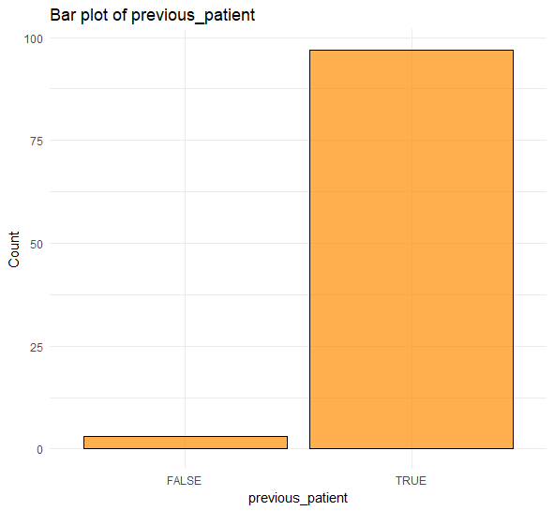
Insights Top 100
Notes:
According to the prediction model, patients between the age of 70/80 have the highest chances of being readmitted. An overwhelming majority of the patients in the top 100 selected by the model have previously been a patient of the hospital, potentially signalling as “problem” patients with reoccurring problems however, most people have been in a hospital in their life before so that indicator might not be as relevant.

Slide 14
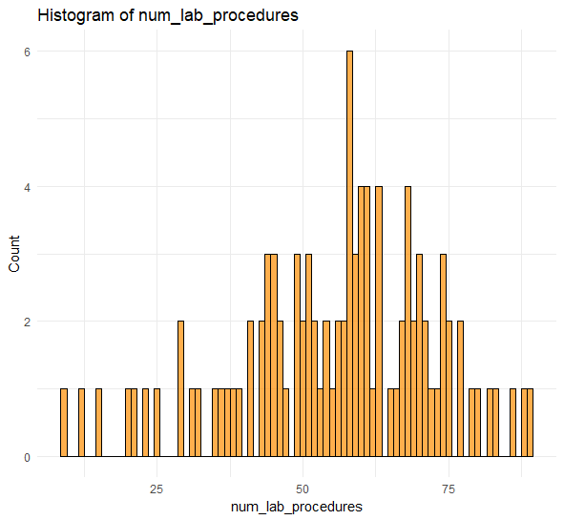
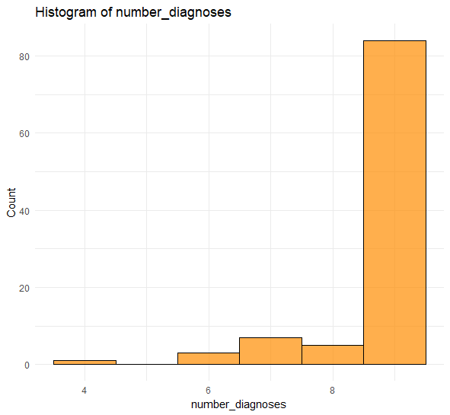
Insights Top 100
Notes:
Patients in the top 100 have a significantly high number of lab procedures done during their treatment in the hospital. This in combination with a high number of diagnoses signal that such patients might have problems that are hard to identify, leading to many lab procedures and varying diagnoses while trying to figure out the causes for their symptoms. These patients then might be discharged too early because the medical staff has exhausted their standard procedures in making the correct diagnose. Supposedly some of them are readmitted because the root cause has not been properly identified and the problems rapidly come back after discharge.

Slide 15
Conclusion & Recommendations

Slide 16

Don’t discharge too early
Special care for older patients
Varying diagnoses -> Transfer to expert
Promote weight loss
Be wary of discharging home with assistance
Notes:
Taking into consideration the data that has been analyzed, the following recommendations can be made for the hospital to minimize teir patients chances of being readmitted within 30 days of discharge. The hospital should try not to discharge patients too early, especially patients with varying diagnoses and a high number of lab procedures done during their treatment time in the hospital. Such patients should instead be considered to be transferred to an expert facility where the correct diagnoses can be made for the patient to betreated appropriately. In addition to that the hospital should be especially wary of discharging patients to home with assistance. Oftentimes the provided assistance might not be sufficient to appropriately deal with the patients needs leading to an early readmission. The hospital should furthermore focus on providing special attention and care for their older diabetic patients and try to promote weigh loss for overweigh patients according to the BMI.

Slide 17
Sources:
Yuan, Z., Cheng, Y., Han, J., Wang, D., Dong, H., Shi, Y., Poulsen, K. L., Fan, X., & Zhao, J. (2022). Association between metabolic overweight/obesity phenotypes and readmission risk in patients with lung cancer: A retrospective cohort study. EClinicalMedicine, 51, 101577. https://doi.org/10.1016/j.eclinm.2022.101577

Slide 18
Appendix

Slide 19
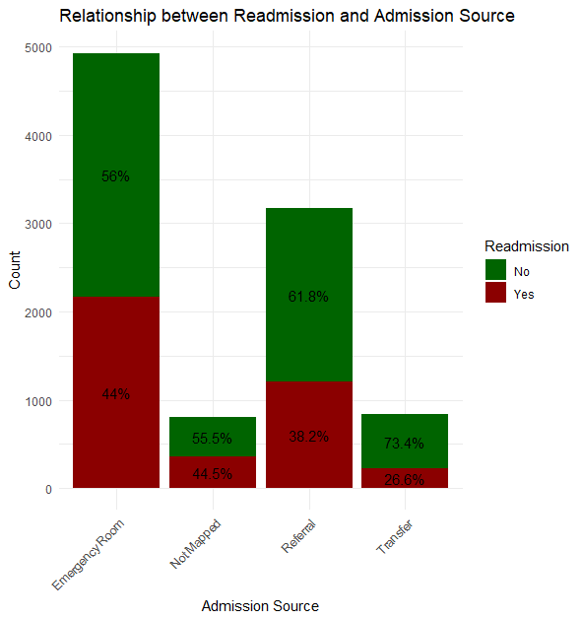
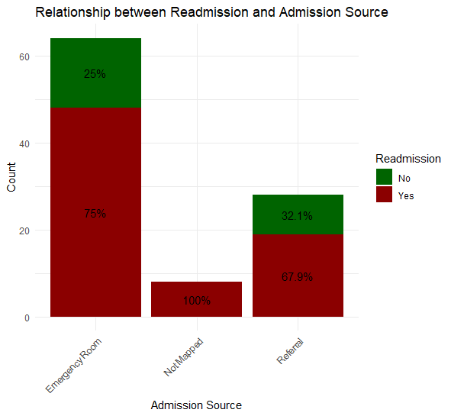
Data Prediction
Notes:
This has been added to appendix because it yields similar insights as admission type, that was included in the presentation

Slide 20
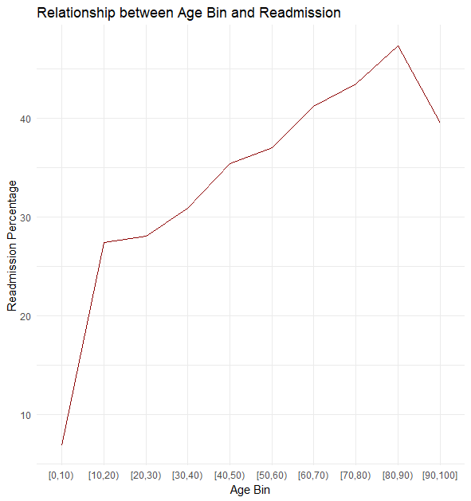
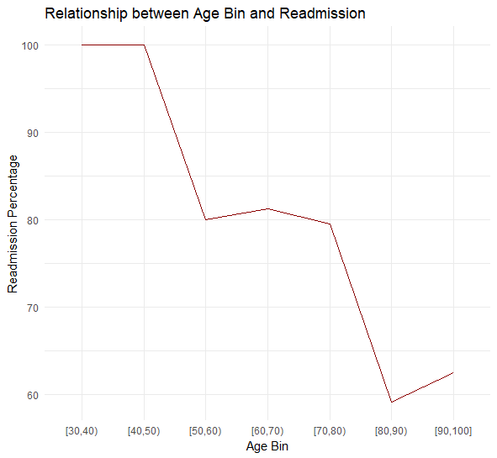
Data Prediction
Notes:
This was added to appendix because it shows slightly ambiguous insights which could confuse the audience, however it can be referenced to see the trend that looking at a larger amount of data, generally older people are more likely to be readmitted.

Slide 21
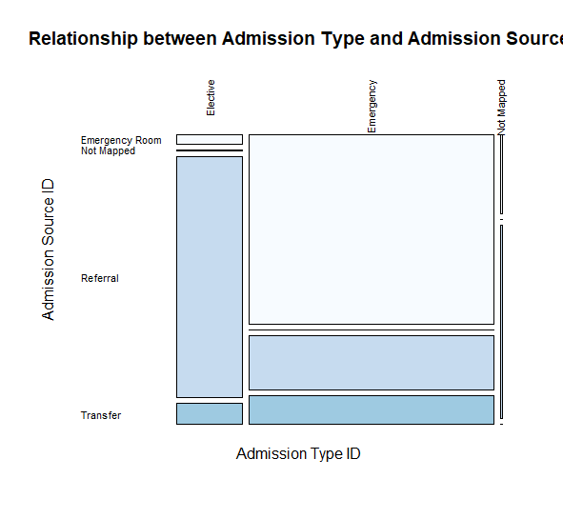
Notes:
Added for reference since I mention this relationship in assumptions section

